Slide 1
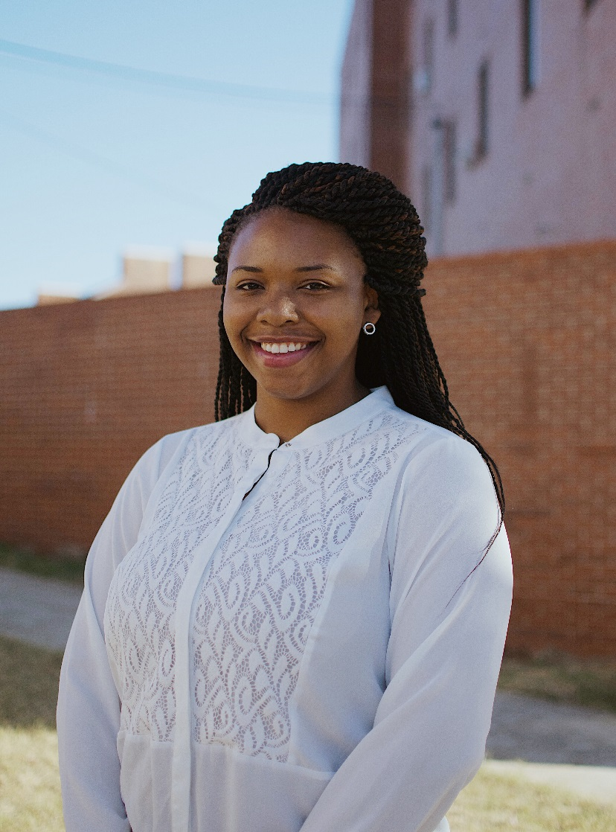
Alabama Past State Presidents’ Endowment $1200 Mary Louise Smith Memorial Endowment $2000
ESA Foundation Scholarships
Devin Mitchell

Slide 2
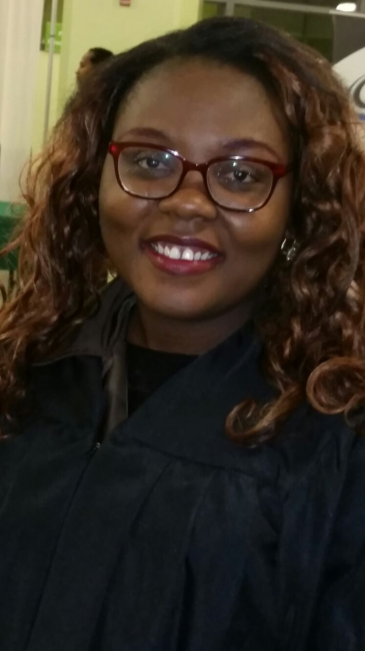
Alice / Jeanne Wagner Endowment $750 Second Chance Endowment $1500
ESA Foundation Scholarships
Olufunmilayo Ashiru

Slide 3
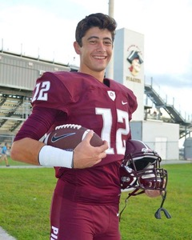
Alice/Jeanne Wagner Endowment $750
ESA Foundation Scholarships
Niklas Traylor

Slide 4
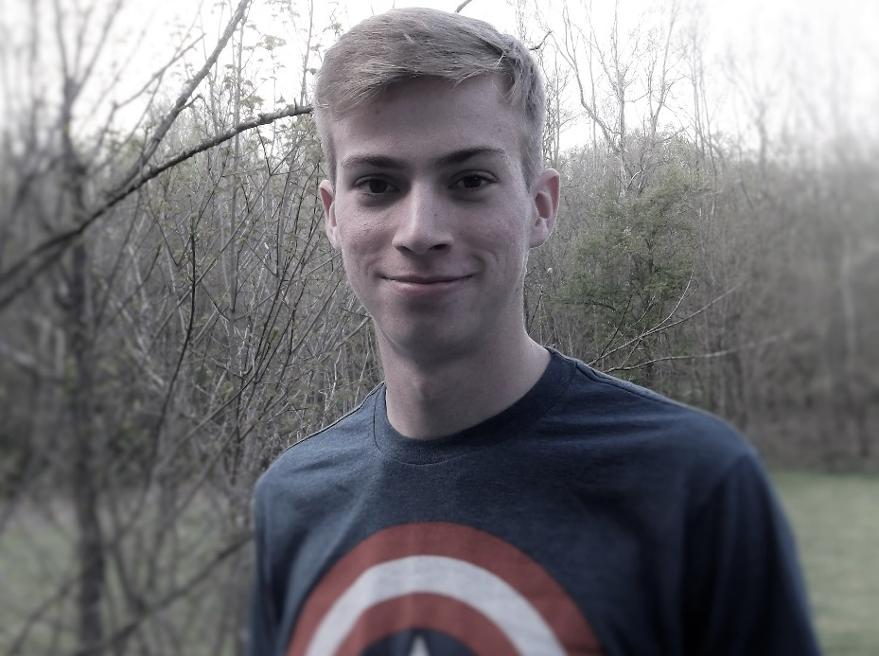
Allen/Files Endowment $750
ESA Foundation Scholarships
Luke Morgan

Slide 5
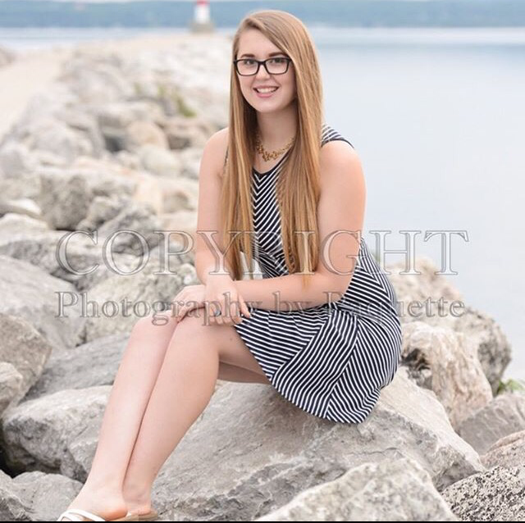
Alpha Kappa #4401 / Jean Hall Endowment $500
ESA Foundation Scholarships
Audrey Giammalva

Slide 6
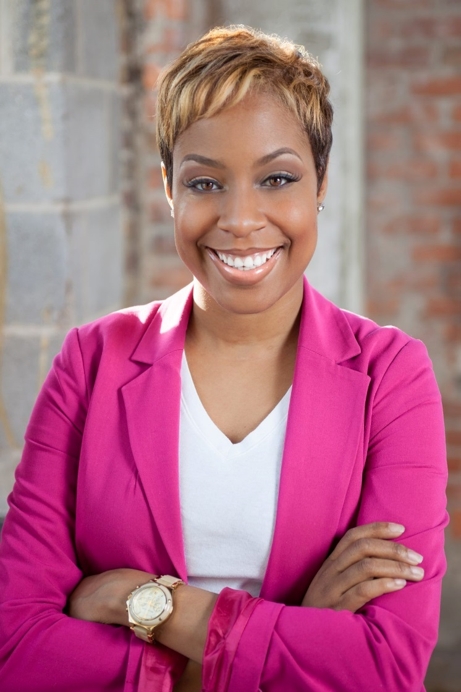
Alpha Kappa #4401/Jean Varga Endowment $500 Alpha Kappa #4401/Joann Zaleski Endowment $600
ESA Foundation Scholarships
Kaci Jackson

Slide 7
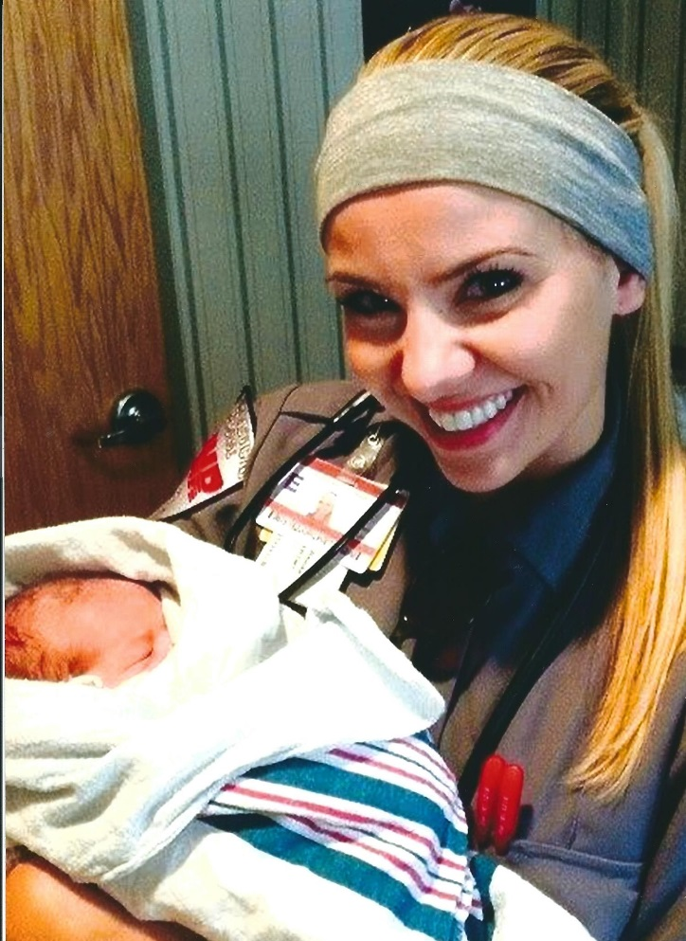
Alpha Kappa #4410/Michelle J Doherty Endowment $500 Peggy Jacques Memorial Endowment $500
ESA Foundation Scholarships
Tiffany Reinke

Slide 8
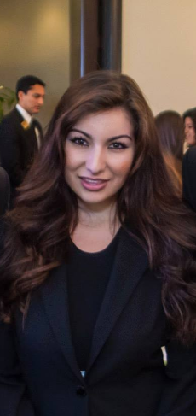
Alpha Omicron #2520 Arizona Endowment $1000 Arizona Council Endowment $500 Arizona Council Sunshine Fund Endowment $750 Elsie and Jay Vogler Memorial Teaching Endowment $500 Lois E Carter Memorial Teaching Endowment $500 Priscilla Gale Memorial Endowment $750
ESA Foundation Scholarships
Taylor Pineda

Slide 9
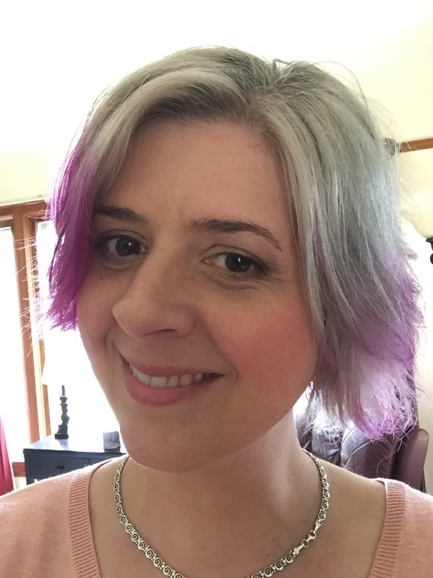
Alpha Upsilon #1884 Oregon Endowment $900
ESA Foundation Scholarships
Heather Roberts

Slide 10
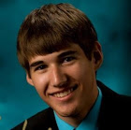
Ann and Bob Becker Endowment $750 Cora E and Royal L Scott Family Endowment $750 Drs. Sidney and Corinne Milburn Memorial Endowment $750 MARC Endowment $1000
ESA Foundation Scholarships
Michael Sperry

Slide 11
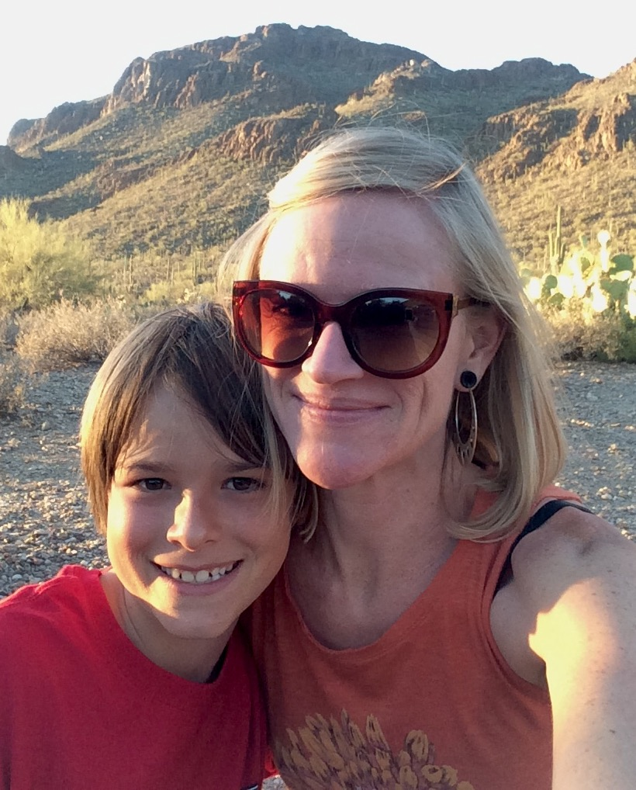
Arizona Council Sunshine Fund Endowment $750
ESA Foundation Scholarships
Danyelle Khmara

Slide 12
Arkansas State Council Endowment $600 Rosagene Huggins Memorial Endowment $600
ESA Foundation Scholarships
Morgan Ware

Slide 13
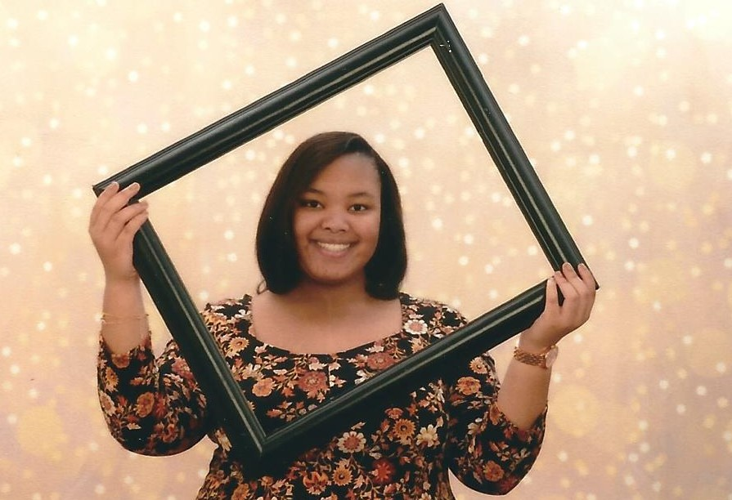
Arlene and Dennis Schlosser Memorial Endowment $3000
ESA Foundation Scholarships
Jalisa Jackson

Slide 14
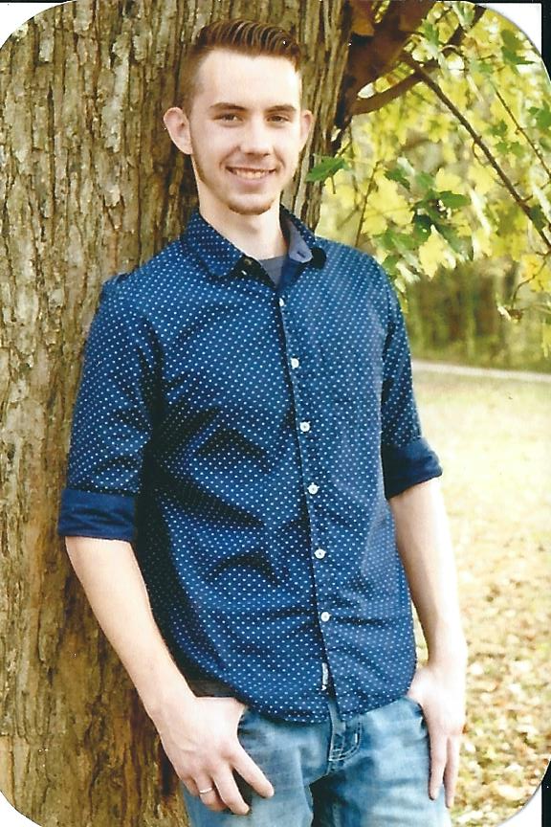
ESA Foundation Scholarships
Arlene and Dennis Schlosser Memorial Endowment $3000
Josiah Williford

Slide 15
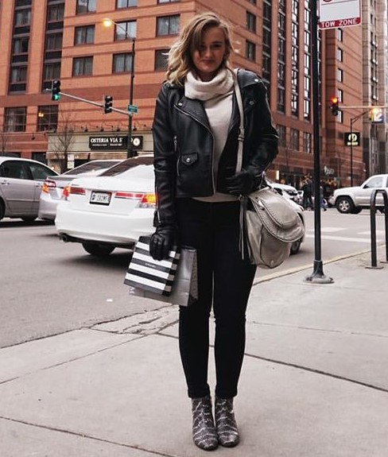
ESA Foundation Scholarships
Arlene and Dennis Schlosser Memorial Endowment $3000
Karli Coffinger

Slide 16
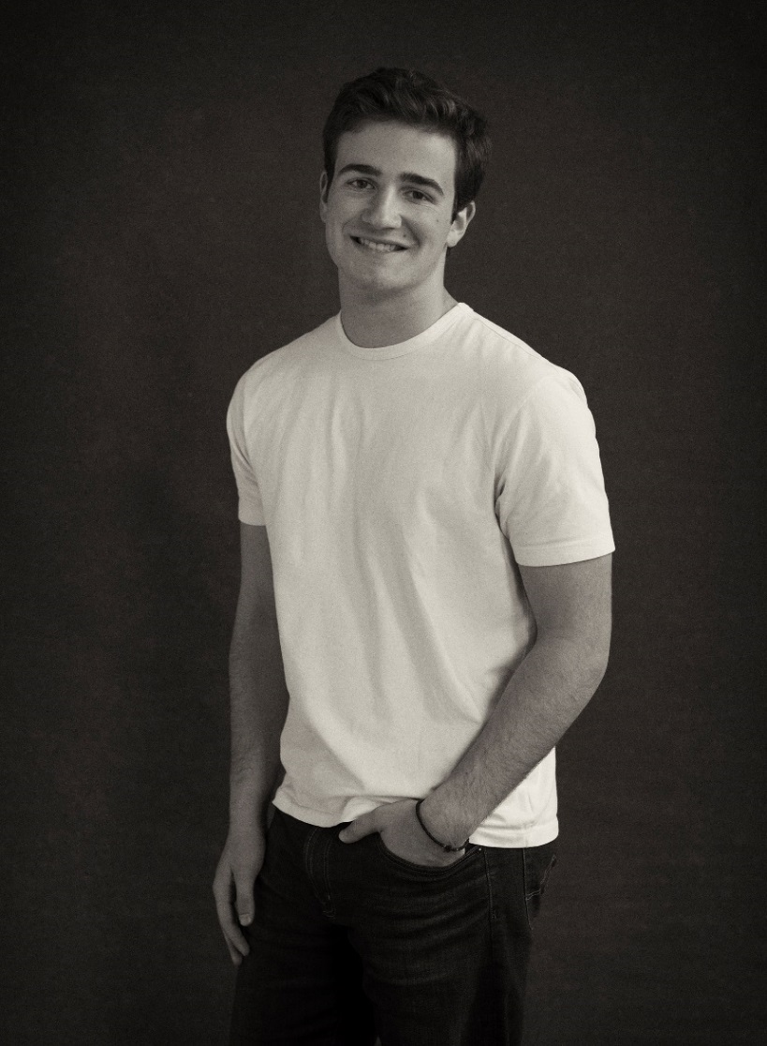
ESA Foundation Scholarships
Arlene and Dennis Schlosser Memorial Endowment $3000
Zane Jarecke

Slide 17
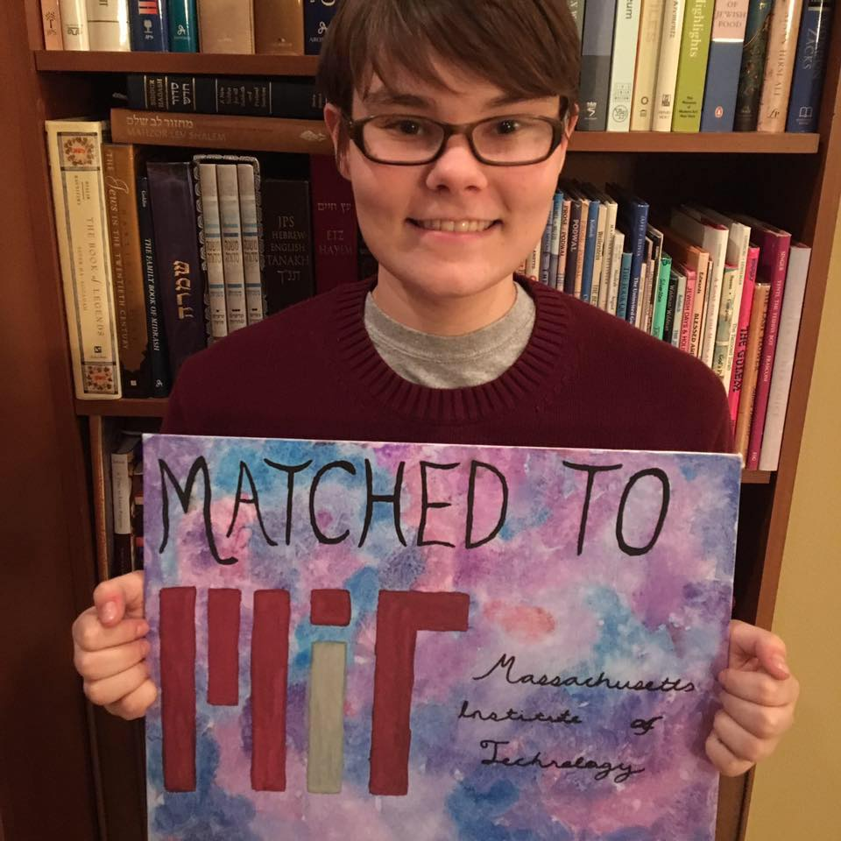
Arlene and Dennis Schlosser Memorial Endowment $3000 Mary Louise Smith Memorial Endowment $2000 Jean Merrill General Honorarium Endowment $1000
ESA Foundation Scholarships
Jade Fischer

Slide 18
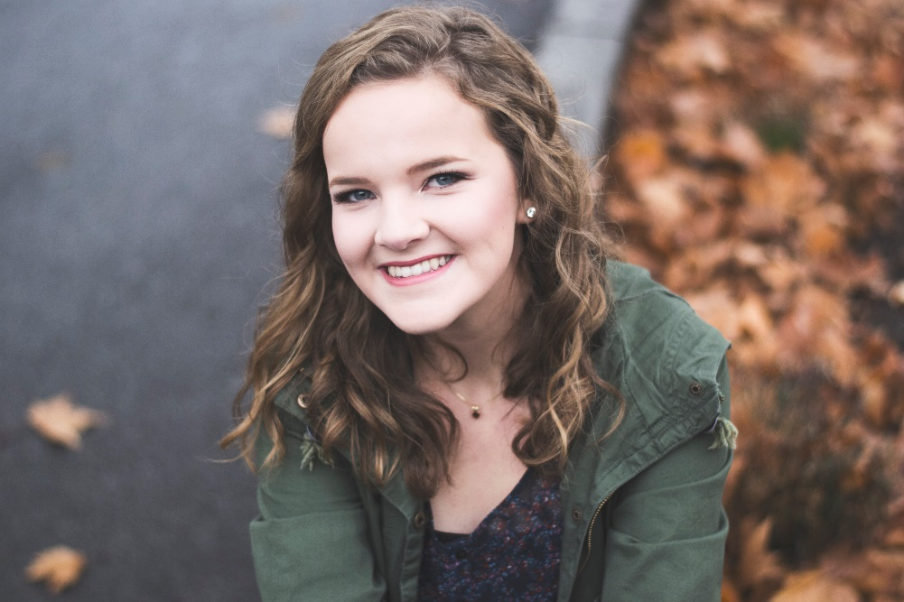
Arlene and Dennis Schlosser Memorial Endowment $3000 Omicron – Tacoma, Washington Endowment $600
ESA Foundation Scholarships
Kamryn Allen

Slide 19
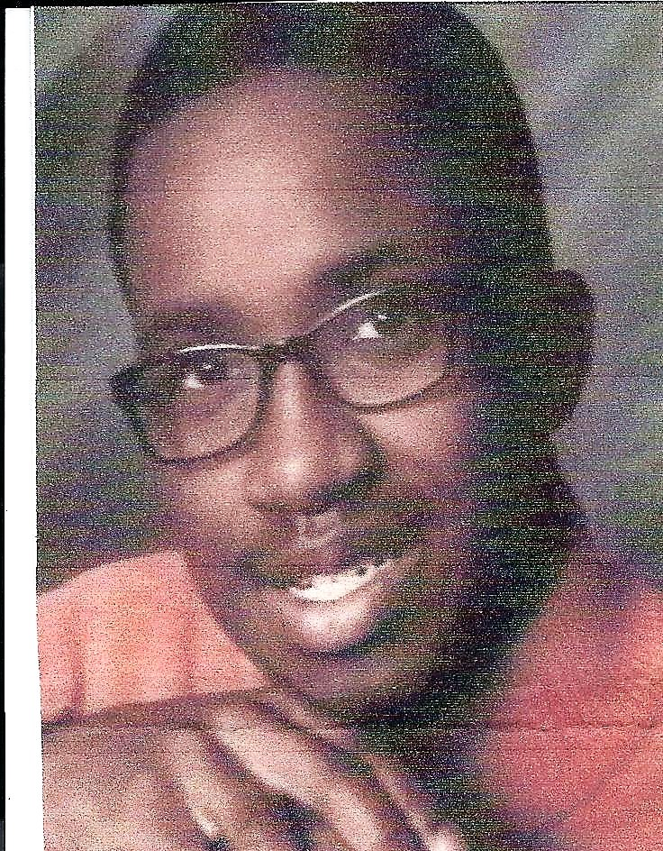
Art & Sandy Fuller Endowment $600
ESA Foundation Scholarships
Collin Davis

Slide 20
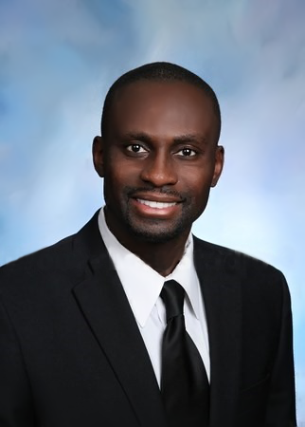
Ayers/Gallatin Endowment $900 Ruth Gregg Memorial Endowment $750 Worda Russell Memorial Endowment $750 Linda Schmidt General Honorarium Endowment $1000
ESA Foundation Scholarships
Albert Appouh

Slide 21
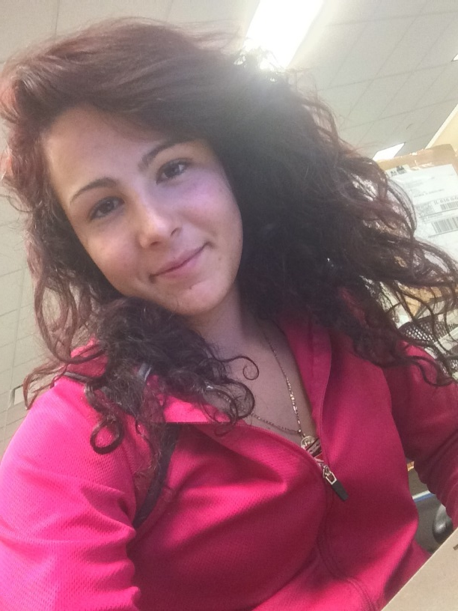
Billy Brockmann Memorial Endowment $1250
ESA Foundation Scholarships
Erica Anaya

Slide 22
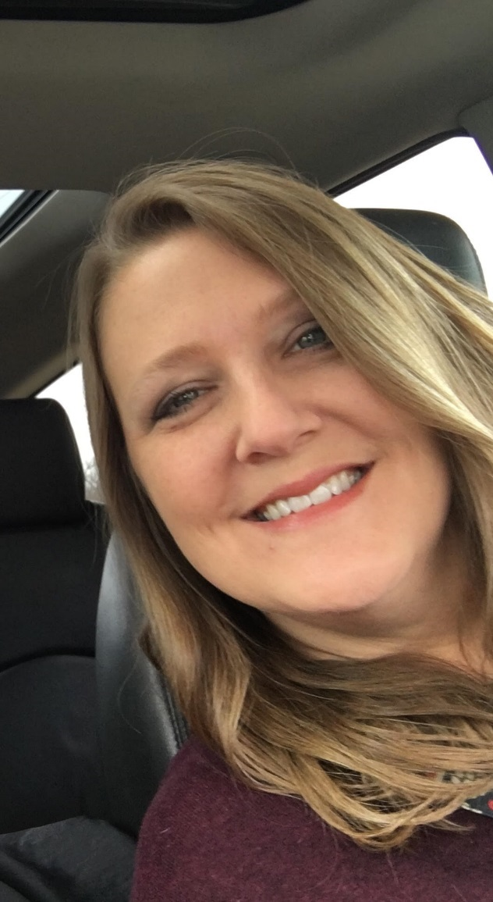
BMW Hope Endowment $750
ESA Foundation Scholarships
Amy Howe

Slide 23
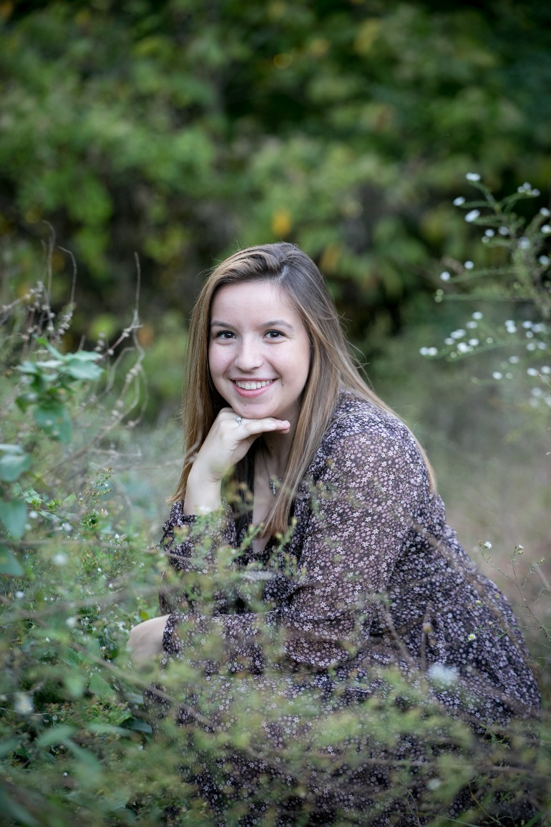
Bob and Jane Jones Endowment $500
ESA Foundation Scholarships
Maya Westberg

Slide 24
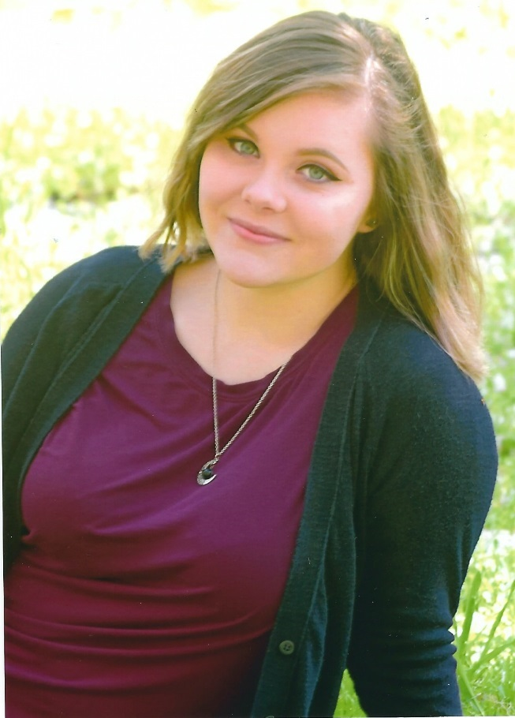
California State Council/EM Bullock Memorial Endowment $500 California State Council Past President Auxiliary Endowment $500
ESA Foundation Scholarships
Amy Cossey

Slide 25
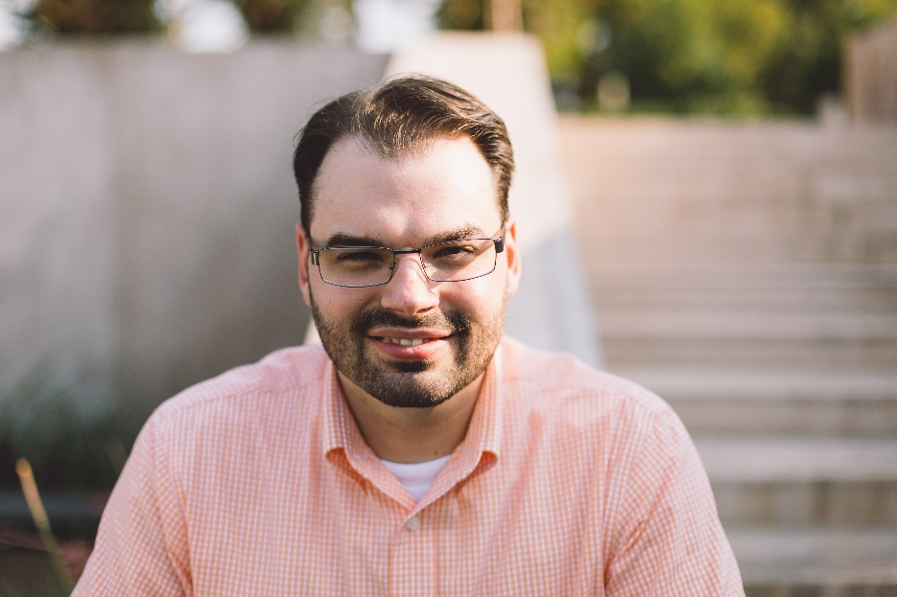
Carol Murphy Memorial Endowment $500
ESA Foundation Scholarships
Christian Messemer

Slide 26
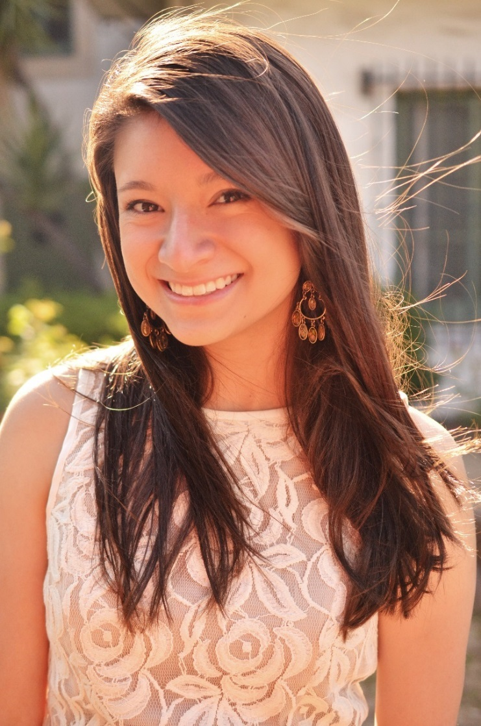
Colorado Lamplighters Endowment $500 Colorado Lamplighters/Beta Omicron Endowment $900
ESA Foundation Scholarships
Bethany Ho

Slide 27
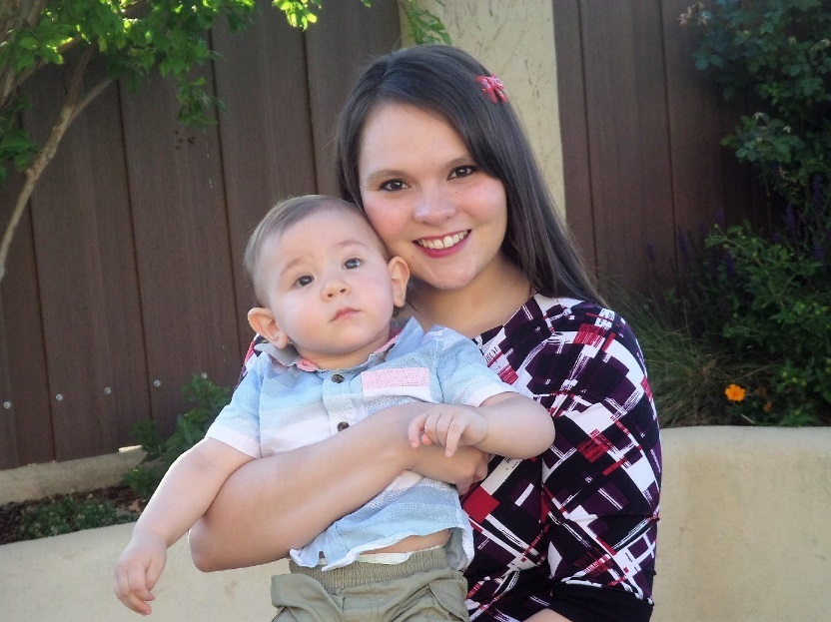
Deborah Humphrey Endowment $1200 Angie Butenschoen General Honorarium Endowment $1000
ESA Foundation Scholarships
Victoria Holt

Slide 28
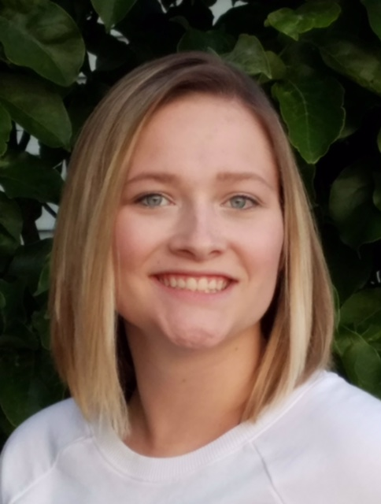
Dorothy Dyer Vanek Endowment $1000
ESA Foundation Scholarships
Sydney Strawer

Slide 29
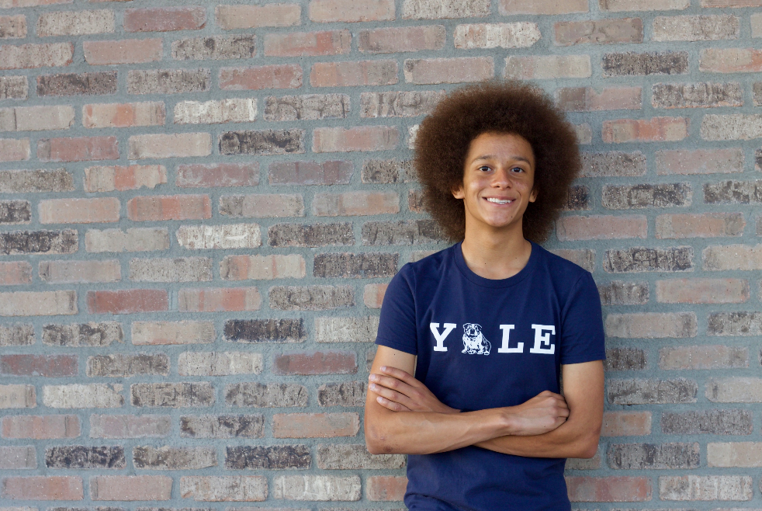
ESA Foundation Scholarships
Dorothy Dyer Vanek Endowment $1000
C Payne

Slide 30
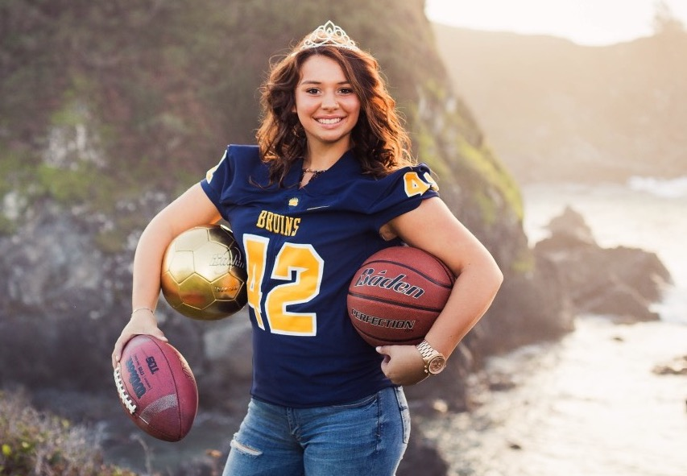
ESA Foundation Scholarships
Dorothy Dyer Vanek Endowment $1000
Siena Worthey

Slide 31
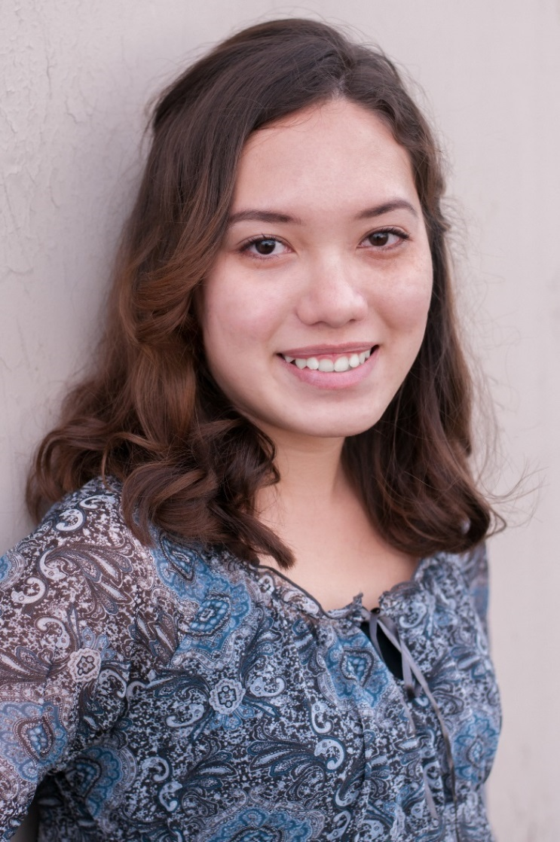
Dorothy Hendricks Endowment $1000 Margaret ‘Peggy’ Rader Memorial Endowment $2000 Washington State Endowment $600
ESA Foundation Scholarships
Lila Faulhaber

Slide 32
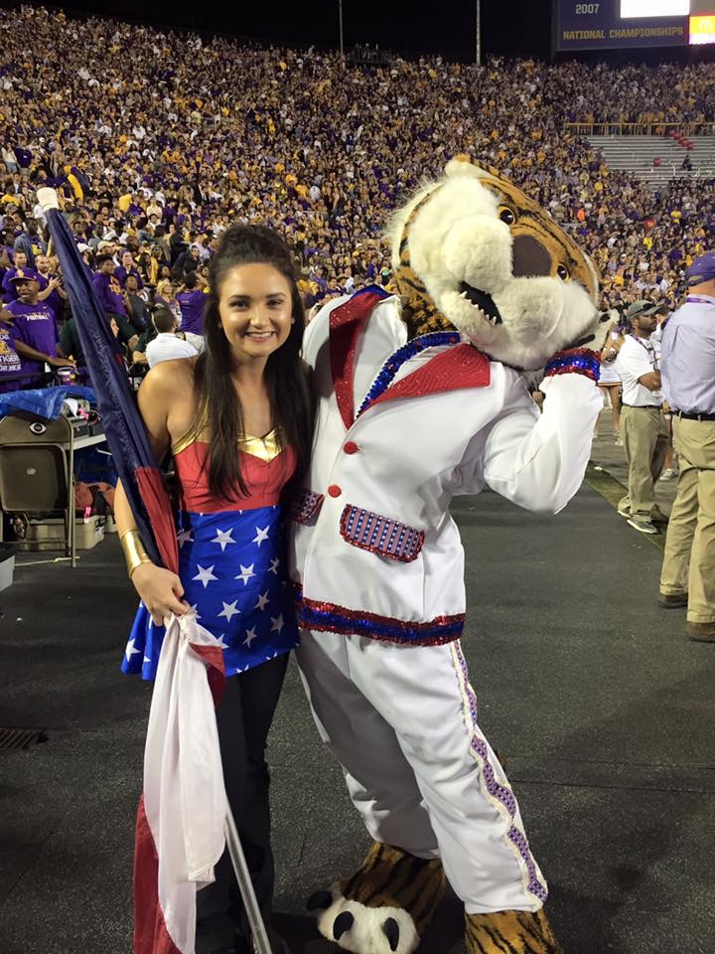
Eloise Collins Endowment $600
ESA Foundation Scholarships
Madeleine Soileau

Slide 33
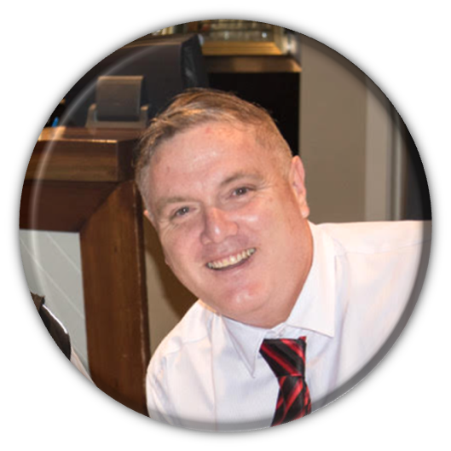
Emily Thomas Memorial Endowment $800
ESA Foundation Scholarships
Stuart Allan

Slide 34
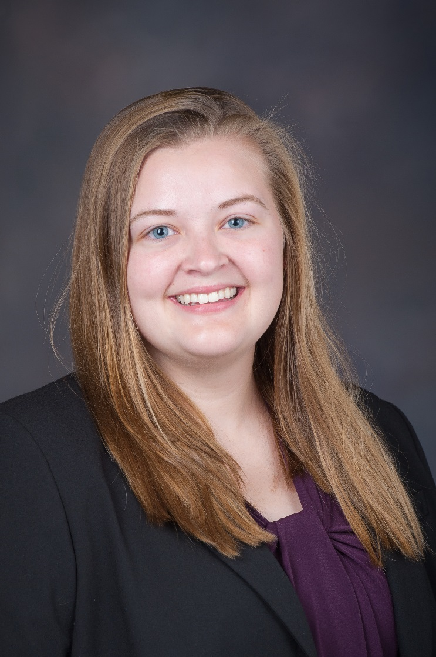
Epsilon Eta/Linda Cronin Memorial Endowment $600
ESA Foundation Scholarships
Valerie Binns

Slide 35
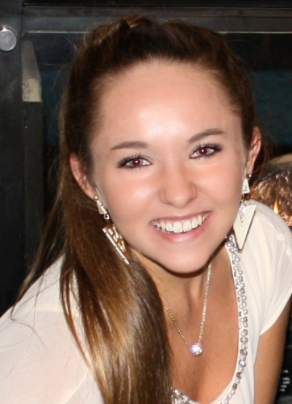
ESA Foundation Endowment $800 Jan Reppentine/Arkansas State Council Endowment $500 SERC Endowment $500
ESA Foundation Scholarships
Teah Flynn

Slide 36
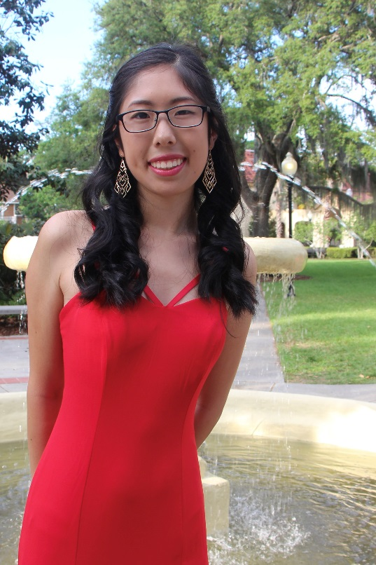
Frances Shugart Endowment $600
ESA Foundation Scholarships
Wendy Tan

Slide 37
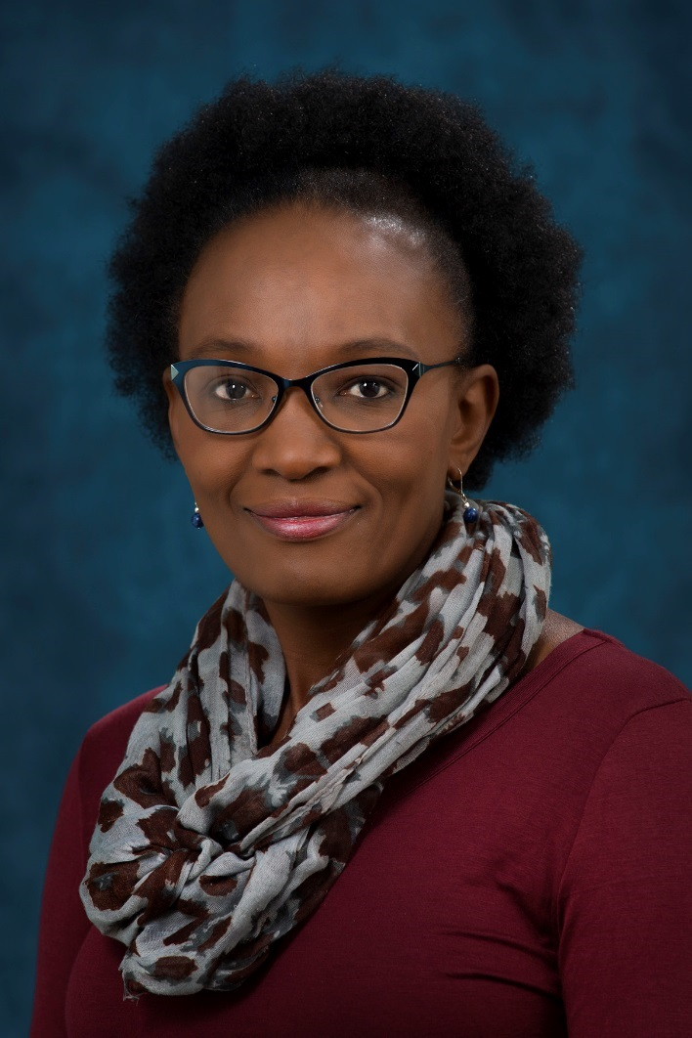
Gordon and Betty Cape Continuing Education Endowment $500
ESA Foundation Scholarships
Lillan Kaplen

Slide 38
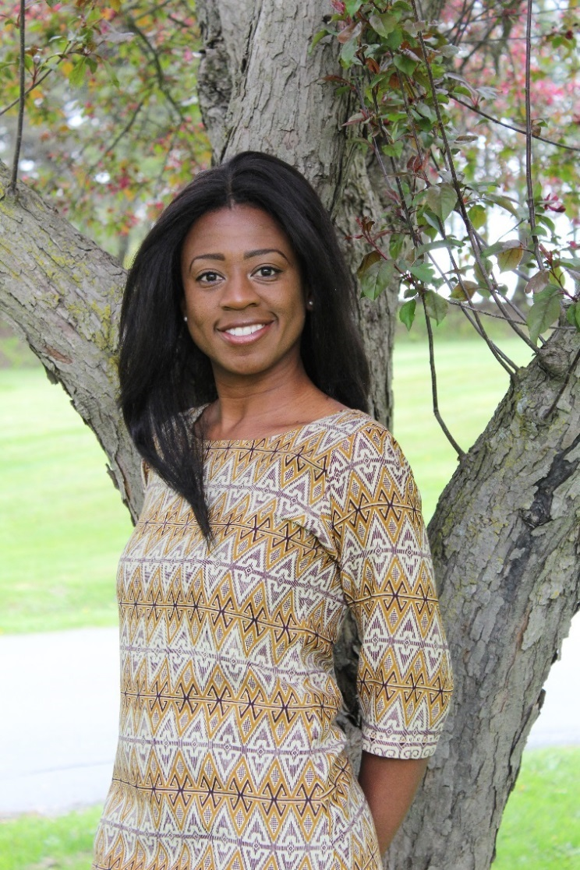
Graduate Studies Endowment $5000 Mary Louise Smith Memorial Endowment $2000 Maxine Wirth Graduate Studies Endowment $1500
ESA Foundation Scholarships
Folake Oyegbola

Slide 39
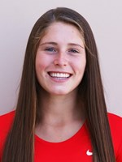
Hazel Knapp Endowment $1000 Jerry & Judith Huntley Endowment $750 Laverne ‘Bun’ Young Endowment $800
ESA Foundation Scholarships
Kelsy Weber

Slide 40
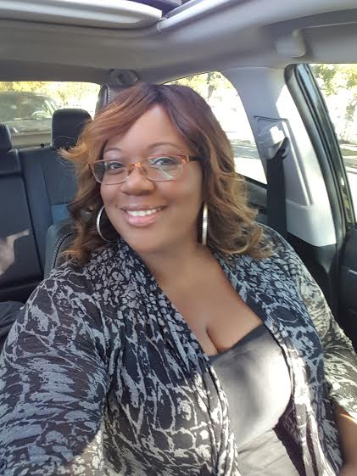
Helping Hands of WSC Endowment $900
ESA Foundation Scholarships
Katherine Butler

Slide 41
Holsted/Simmons/ Haymaker Endowment $1400
ESA Foundation Scholarships
Morgan Pringnitz

Slide 42
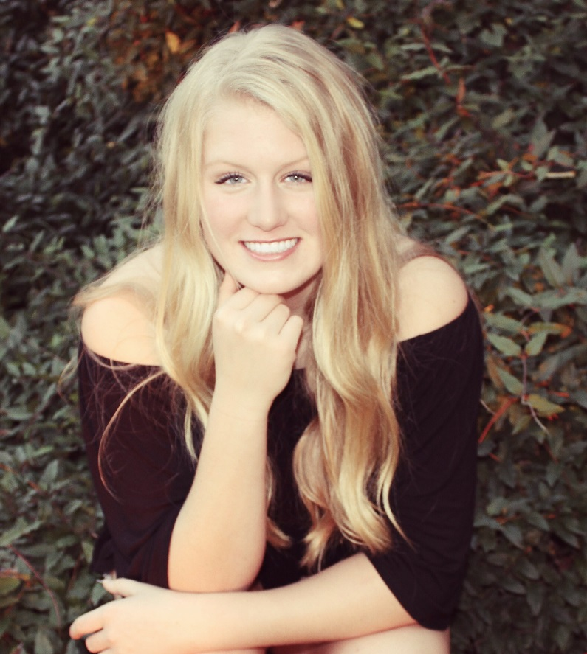
ESA Foundation Scholarships
Holsted/Simmons/ Haymaker Endowment $1400
Maddie Myers

Slide 43
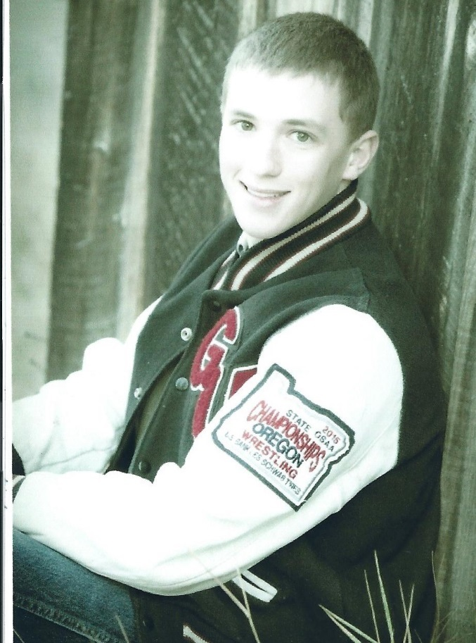
Hope Baney Memorial Endowment $1000
ESA Foundation Scholarships
James Johnson

Slide 44
Hope for Kansas Heroes Endowment $500
ESA Foundation Scholarships
Kinzley Cornwell

Slide 45
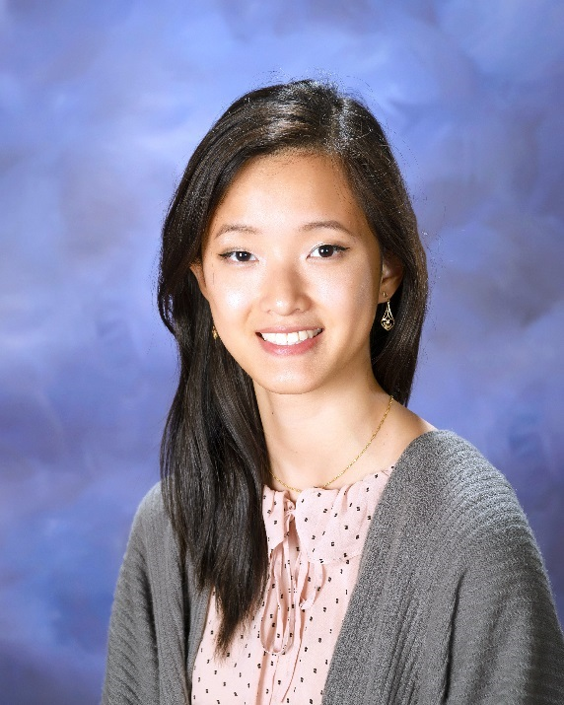
Indiana State Council Endowment $500
ESA Foundation Scholarships
Grace Zhang

Slide 46
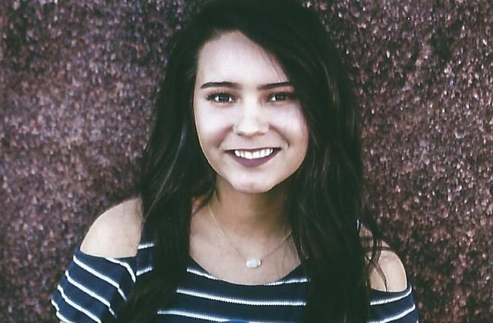
Jack and Lucille Crossno Memorial Endowment $500 Kansas State Council Endowment $1200
ESA Foundation Scholarships
Perla Moncayo

Slide 47
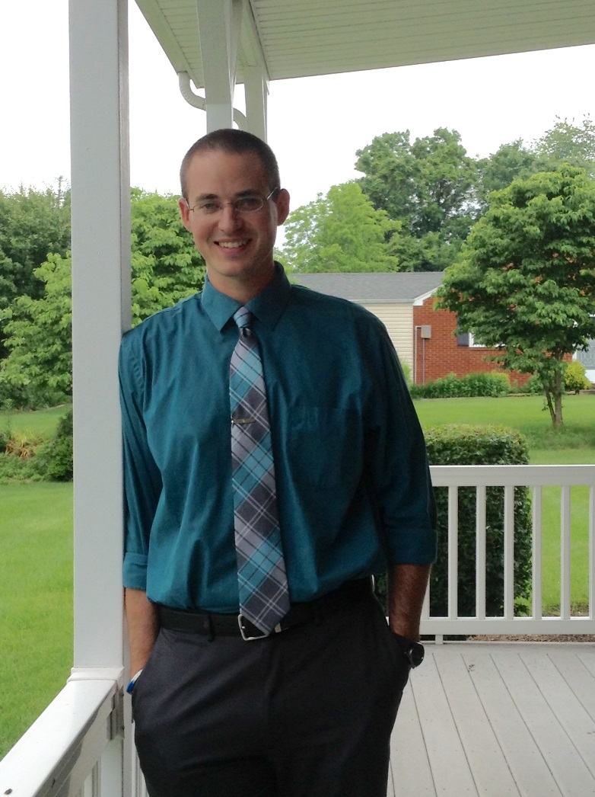
James McPherson Memorial Endowment $1000 Mary Louise Smith Memorial Endowment $2000 Sherman and Nancy Reece Endowment $1500 Carol Worley General Honorarium Endowment $1000
ESA Foundation Scholarships
Justin Bennett

Slide 48
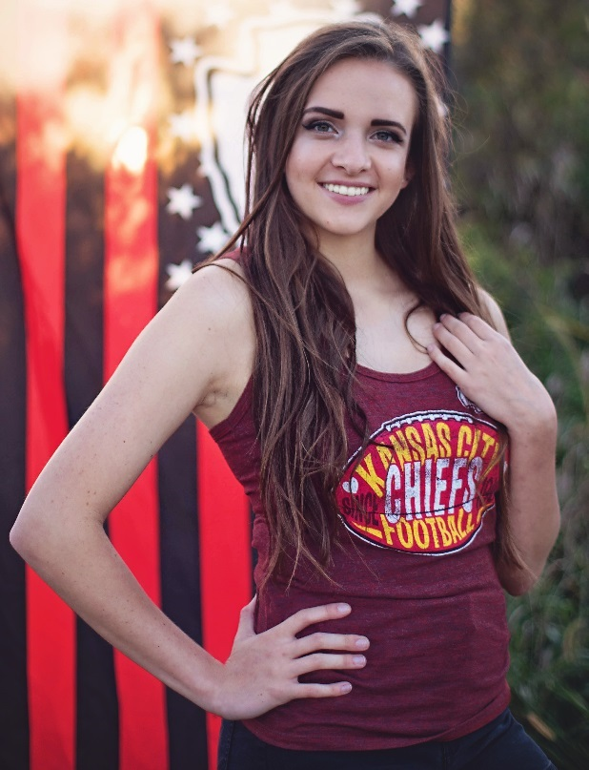
Jay Peckham Pharmacy Endowment $7500
ESA Foundation Scholarships
Jensen Kiesow

Slide 49
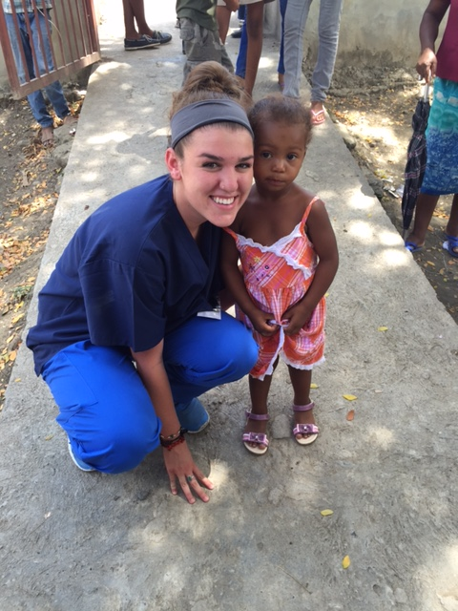
Jeanne Parker Memorial Endowment $750
ESA Foundation Scholarships
Arley Rodriguez

Slide 50
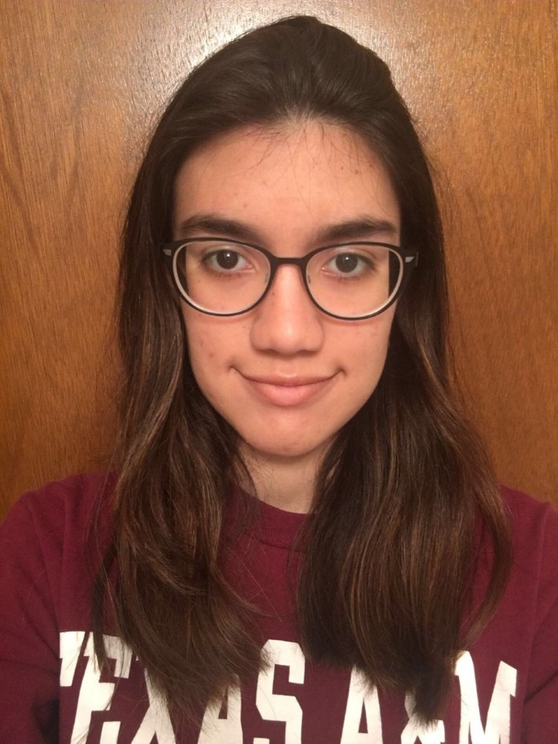
Jerry Harvey Endowment $750
ESA Foundation Scholarships
Adriana Sanchez

Slide 51
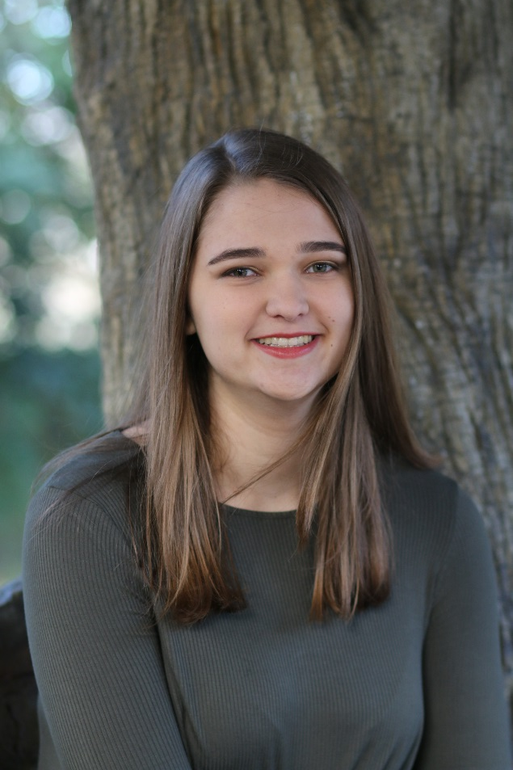
Jerry Harvey Endowment $750 Kay Mills Memorial Endowment $800
ESA Foundation Scholarships
Caroline Matteson

Slide 52
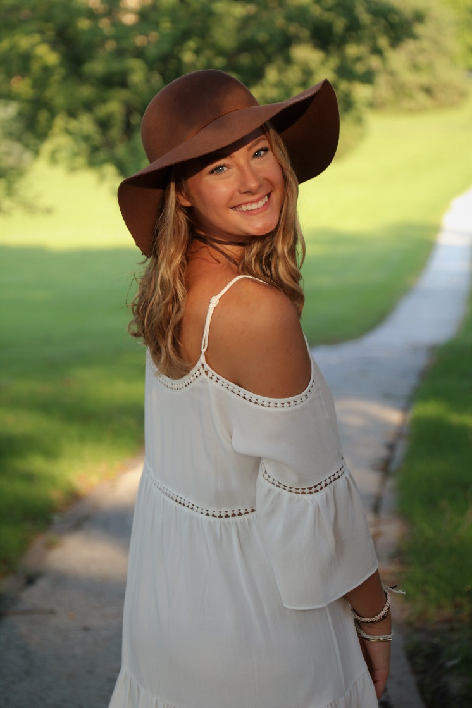
Joan G Monson & Dean E Monson Endowment $500
ESA Foundation Scholarships
Katelyn Krzemien

Slide 53
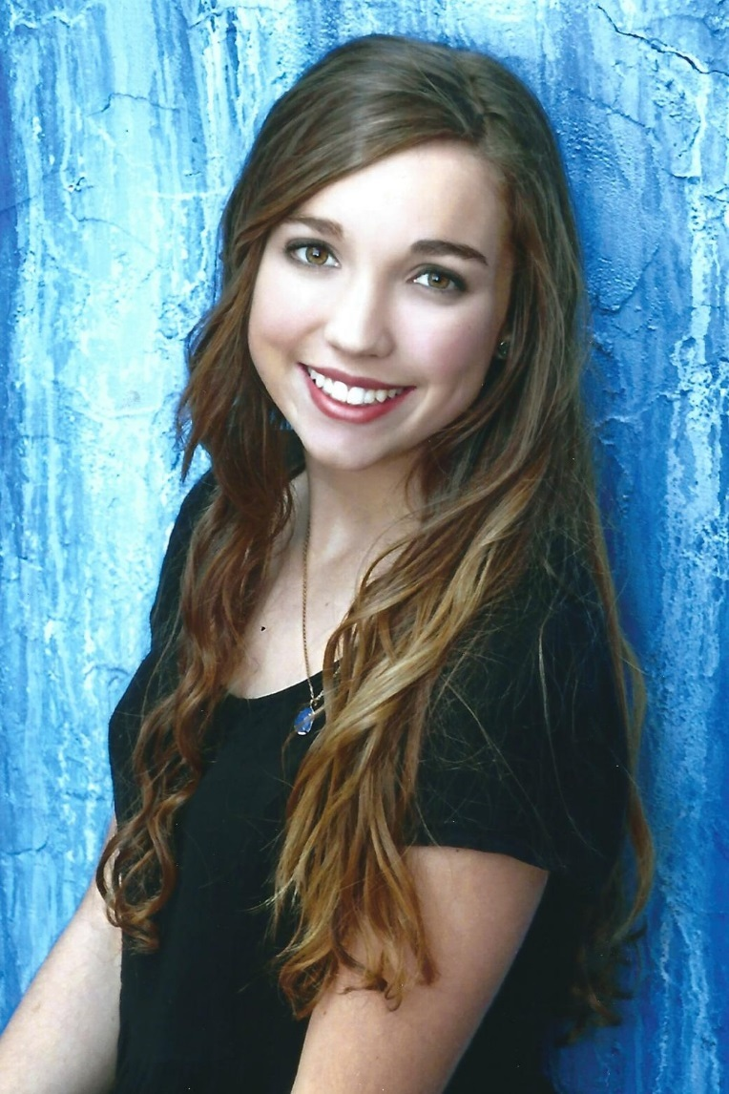
Jordan Griffith Memorial Endowment $600
ESA Foundation Scholarships
Nykol Williamson

Slide 54
Kansas Lamplighter Memorial Endowment $900
ESA Foundation Scholarships
Morgan Feldkamp

Slide 55
Kentucky State Council Endowment $1200
ESA Foundation Scholarships
Tessa Howard

Slide 56
Kristine Williamson Memorial Endowment $600
ESA Foundation Scholarships
Gabe Gilmore

Slide 57
Les and Rosalee Echele Family Endowment $500
ESA Foundation Scholarships
Madeline Wappelhorst

Slide 58
Linda Moore Endowment $500
ESA Foundation Scholarships
Thinh Truong

Slide 59
Lynn and Rich Hughes Family Endowment $1100 Oregon State Council Endowment $1000
ESA Foundation Scholarships
Nikolas Lindauer

Slide 60
Margaret ‘Peggy’ Rader Memorial Endowment $2000
ESA Foundation Scholarships
Katherine Chamberlin

Slide 61
ESA Foundation Scholarships
Margaret ‘Peggy’ Rader Memorial Endowment $2000
Jalena Myers

Slide 62
ESA Foundation Scholarships
Margaret ‘Peggy’ Rader Memorial Endowment $2000
Annabelle Downs

Slide 63
Marjorie J Hamrick Endowment $600
ESA Foundation Scholarships
Callie Barker

Slide 64
Mary Louise Smith Memorial Endowment $2000
ESA Foundation Scholarships
Denton Diggins

Slide 65
Mary Louise Smith Memorial Endowment $2000 Montana State ESA Endowment $900
ESA Foundation Scholarships
Elizabeth Barton

Slide 66
Maxine Wheelan/Delta Chi Endowment $500
ESA Foundation Scholarships
Nadia Khoda

Slide 67
McConnell Family Endowment $1000
ESA Foundation Scholarships
Alexandria Brown

Slide 68
McConnell Family Endowment $1000 Ralph and Ruth Strother Endowment $900
ESA Foundation Scholarships
Jade Massey

Slide 69
McConnell Family Endowment $1000 New Mexico State Council Roadrunner Endowment $700
ESA Foundation Scholarships
Jenica Laney

Slide 70
ESA Foundation Scholarships
Minnesota State Memorial Endowment $1000
Najaha Musse

Slide 71
Minnesota State Memorial Endowment $1000
ESA Foundation Scholarships
Danielle Tran

Slide 72
Missouri GICC Endowment $500
ESA Foundation Scholarships
Colleen Doyle

Slide 73
Missouri State Council Endowment $600
ESA Foundation Scholarships
Ashley Windsor

Slide 74
Missouri Torchbearers’ Endowment $1200
ESA Foundation Scholarships
Sara Gammon

Slide 75
Nancy Jo Fox Memorial Endowment $750
ESA Foundation Scholarships
Emma Cape

Slide 76
Nebraska ESA Endowment $900
ESA Foundation Scholarships
Terese Navarra

Slide 77
Neta Hendricks Memorial Endowment $500
ESA Foundation Scholarships
Eliana Benevento

Slide 78
Ohio State Council/Nancy Waymire Memorial Endowment $700
ESA Foundation Scholarships
Timothy Heaton

Slide 79
Oklahoma District II Endowment $500
ESA Foundation Scholarships
Ivy Borders

Slide 80
Oscar and Joyce Whitewing Honorarium Endowment $900
ESA Foundation Scholarships
Kiet Nguyen

Slide 81
Phyllis Shoemaker Memorial Endowment $600
ESA Foundation Scholarships
Ma Anderson

Slide 82
Shirley A Dreyer Memorial Endowment $700
ESA Foundation Scholarships
Akpovona Ojaruega

Slide 83
ESA Foundation Scholarships
Shirley A Dreyer Memorial Endowment $700
Heather Wood Buzzard

Slide 84
Tulsa Area Council Endowment $500
ESA Foundation Scholarships
Faith Harl

Slide 85
Virginia State Endowment $800
ESA Foundation Scholarships
Gelila Kassaye

Slide 86
West Virginia Endowment $800
ESA Foundation Scholarships
Sarah Stewart

Slide 87
Wisconsin Endowment $500
ESA Foundation Scholarships
Ismael Coello

Slide 88
York Family Endowment $500
ESA Foundation Scholarships
Chelsee Aguirre

Slide 89
Judges General Honorarium Endowment $500
ESA Foundation Scholarships
Kristen Reid

Slide 90
Sunya Decker Early Bird General Honorarium Endowment $500
ESA Foundation Scholarships
Katherine Regis

Slide 91
Scholarship Processing Team General Honorarium Endowment $1000
ESA Foundation Scholarships
Savannah Gorman

Slide 92
2016-17 State Counselors General Honorarium Endowment $1000
ESA Foundation Scholarships
Meagan Sojka

Slide 93
Bobbie Massey General Honorarium Endowment $1000
ESA Foundation Scholarships
Christina Szachon

Slide 94
Sherri Fuhrer General Honorarium Endowment $1000
ESA Foundation Scholarships
Jazz Duncan

